Slide 1
Examining popularity of Chinese restaurants in the Houston area
Wei Guo

Slide 2
Background and Vision
To promote and advocate a healthy lifestyle, I want to open a Chinese healthy breakfast bar in Houston.
The main goal of the project is to find the optimal location.

Slide 3
Data sources and description
Explore the foursquare API
50 Chinese restaurants within a 6 mile radius around my home address.
The responses and reviews for each restaurant will be collected.
The responses contain the ratings, the price tiers, and the number of likes.
The response data will be integrated with latitude and longitude coordinates values to cluster the current Chinese restaurants by using unsupervised k-means methods.

Slide 4
Results

Slide 5
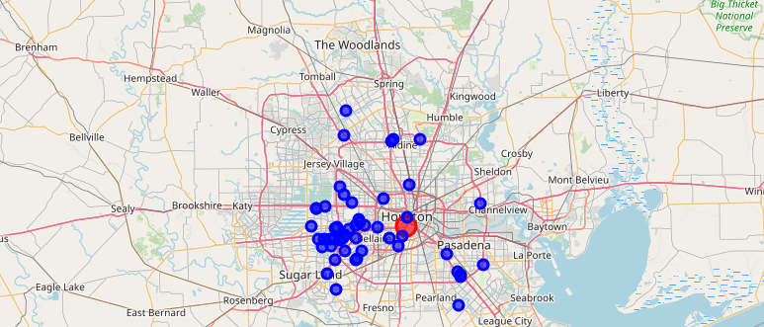
Map1: Distribution of the Chinese restaurants in Houston area

Slide 6
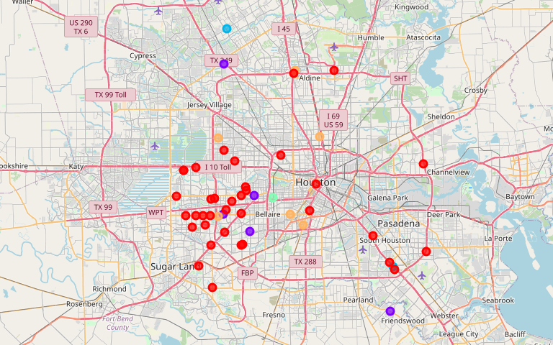
Map2: K-means clustering showing 5 clusters

Slide 7
Table 1: The characters of the five clusters
cluster | color | size | Latitude | Longitude | Location | Rating | price tier | Likes
0 | Red | 36 | 29.723964 | -95.486482 | Chinatown | 5 | 1.08 | 0.36
1 | Purple | 5 | 29.723879 | -95.458081 |  | 7.04 | 1.4 | 14
2 | Blue | 2 | 29.815982 | -95.37841 |  | 7.75 | 1.5 | 21.5
3 | Green | 1 | 29.732873 | -95.449335 |  | 7.6 | 1 | 29
4 | Orange | 6 | 29.784847 | -95.446935 | Chinatown | 5.91 | 1.16 | 4.5
total |  | 50 | 29.756309 | -95.4438486 |  | 6.66 | 1.228 | 13.872

Slide 8
Discussion
1. The numbers of restaurants are limited because of API day search limits
2. Clusters not strictly limited by geographical proximity because we put several other performance factors into consideration.
3. Chinatown is not the most highly liked or rated cluster.

Slide 9
Conclusion
The data suggest that Houstonians have high interest in Chinese food options across the entire city. However, demand seems to be concentrated in specific neighborhoods, such as Midtown and southeast/northwest suburbs. Although the conclusion of the project is that any location has the potential to succeed, and that we should prioritize the quality of food rather than picking an ideal location.

